Slide 1
Linux Administration
Week 2
Users

Slide 2

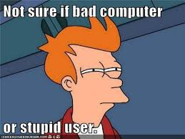



Users, can't live with 'em, can't live without 'em

Slide 3
Best Practices
When someone is hired/fired what is the procedure? Make a script
Document EVERYTHING and keep your documentation up to date
Lock admin/root accounts unless absolutely needed (sudo instead)
Allow remote access on an as needed basis
Backup everything
onsite vs offsite options
Single sign on (SSO) vs multiple accounts/passwords
Multi Factor authentication

Slide 4
User Security and Least Privilege
The principle of Least Privilege
Better stability and security
Be careful and polite, can lead to antagonistic encounters with users
Root vs sudo
Disk usage
Is the user using an odd amount for their needs?
Tools like fail2ban
Bans login after unsuccessful attempts

Slide 5
Password management
Multi factor authentication
Password length
Special Characters
Password ageing and frequency of changing (No longer recommended)
Restrict using old passwords
Some places started checking to see if password was stolen before allowing it to be used
https://haveibeenpwned.com/
You can also consider things like calculating how long it would take to break a password before allowing it's use
https://web.archive.org/web/20210518064200/http://www.mandylionlabs.com/PRCCalc/BruteForceCalc.htm

Slide 6

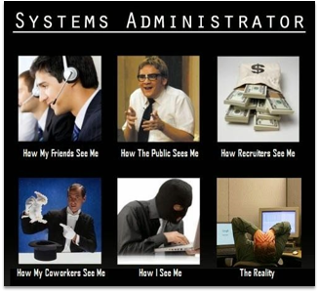
Types of Accounts
System accounts
For example, Apache for Web
Daemons (Background processes)
User accounts
Admin and root accounts
Linux was by default a multi user system

Slide 7
Key files
/etc/passwd - user acct info : user:password:UID:GID:comment:shell
/etc/shadow - encrypted passwords (* for system nonlogin, ! for no login like root)
/etc/group - Groups and their users (wheel special group)
/etc/login.defs (defaults for users)
/etc/adduser.conf (systems using adduser instead of useradd)
/etc/sudoers
/etc/motd (login message) (Message of the Day)
/etc/skel (Starting directory setup)

Slide 8
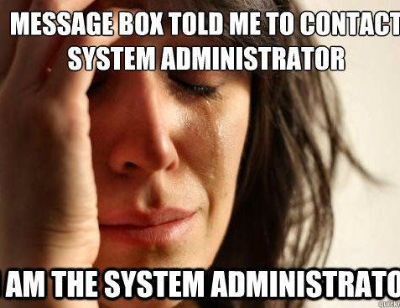
Activity
Go find those files in your system
Add their location to your documentation

Slide 9
Users and Groups
Users identified by UID
Group by GUID
Both GID and UID default to sequential numbering
User names and why names are important to think about
Why we use groups on servers
Home directory (Where is yours? Is everyone's the same?)
Shells
Different jobs might want different shells, (Dev might want C shell)
Passwords move to /etc/shadow
Special symbols in the password file
*= nologin acct
!= dissallows login
Can also use a false shell or nologin to prevent access without deleting accounts

Slide 10
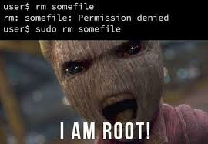
Admin accounts
Sudo
Su will switch user to root
Sudo Run single command with root privilege
!!
Wheel group vs sudoers
Wheel is as if you have root access – legacy
Sudoers add to group to give access
Sudoers has more control
root

Slide 11
Frequently used commands
useradd command is used to create new accounts in Linux
usermod command used to modify the existing accounts in Linux
userdel command is used to delete local account in Linux
passwd command used assign password to local accounts or users.
change command is used to view & modify users password expiry information
groups username #shows groups for a user
lastlog to see last login of users (including never logged in
chpasswd for group password changes (chpasswd < passchangefile #username:password)

Slide 12
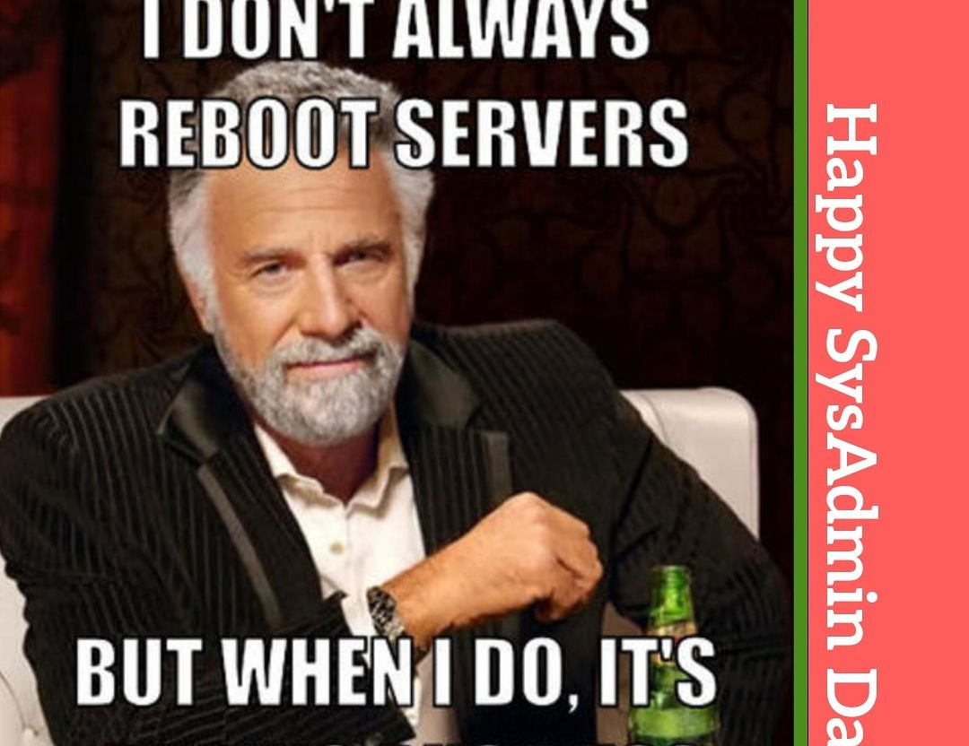
Useful Scripts
Bulk add users
Bulk delete users
With or without file clean up
Disk usage monitoring
Listing accounts that never logged in
List files taken off the server (exfiltration)

